Slide 1



Naan Mudhalvan
Industrial IoT and Industry 4.0
Tektork Private Limited, Coimbatore

Slide 2
Cloud Platform - ThingSpeak
Tektork Private Limited, Coimbatore

Slide 3
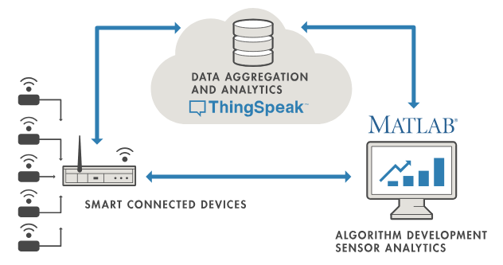
Tektork Private Limited, Coimbatore

Slide 4
ThingSpeak
ThingSpeak is a cloud-based IoT analytics platform that enables live data collection, visualization, analysis, and automated actions, streamlining the development of sensor-based connected applications without requiring users to build or host their own web infrastructure.
It acts as the bridge between resource-constrained hardware and sophisticated cloud-based data processing.
Core Theory and Architecture
ThingSpeak operates by letting IoT devices (sensors, actuators, gateways, edge nodes) send data to the platform via secure web protocols (HTTP REST API, MQTT), commonly using libraries for platforms like Arduino, ESP8266, ESP32, Particle, and Raspberry Pi.
Each data flow is organized in “channels,” which are virtual containers storing up to 8 numerical fields and optional location data (latitude, longitude, elevation) per timestamped entry.
Tektork Private Limited, Coimbatore

Slide 5
Features and Data Operations
Live Data Aggregation:
Devices continuously post real-time sensor or control data to dedicated ThingSpeak channels.
Visualization:
Built-in charting, gauges, historical and geographic maps for live/historic data monitoring; customizable with widgets and MATLAB visualizations.
Analysis & Automation:
Scheduled executions of MATLAB algorithms for data analysis, event detection, predictive functions, and DSP tasks.
Tektork Private Limited, Coimbatore

Slide 6
Features and Data Operations Cond..
Third-party Actions:
Integrations with web services (e.g., Twitter, Twilio), allowing triggers and notifications based on data conditions.
Open Source and Extensible:
ThingSpeak encourages custom plugins and integrations for specific IoT use cases, supporting innovation and collaborative development.
Tektork Private Limited, Coimbatore

Slide 7
Core Components of ThingSpeak
Component | Description
Channel | A virtual container where your data is stored. Each IoT project usually has one channel.
Field | Each channel has up to 8 data fields. Each field stores a specific type of data (e.g., temperature, humidity, LDR).
Channel ID | A unique number assigned to your channel — used to send and read data.
Write API Key | A secret key used to send data to the channel.
Read API Key | A key used to read data from the channel (for dashboards, apps, etc.).
Feeds | Each data entry (timestamp + field values) is called a feed.
Public/Private Channels | Channels can be made public (for anyone to view) or private (only with API key).
Tektork Private Limited, Coimbatore

Slide 8
Workflow: Creating and Using Channels
Sign up on ThingSpeak and create a channel:
Assign a name, description, and define field names based on what your device will send (e.g., "Temperature", "Humidity").
Configure your device/software to POST data:
Use the channel's Write API key and construct the update request (e.g., via
HTTP api.thingspeak.com/update?api_key=YOUR_KEY&field1=value1). Send single data points or batches.
View data instantly:
ThingSpeak displays live charts and visualizations for all fields; historical data can be explored and exported for analysis.
Tektork Private Limited, Coimbatore

Slide 9
Workflow: Creating and Using Channels Cond..
Read data from channels:
Devices or users can fetch past/historic data using the Read API key.
MATLAB analytics in cloud:
Run MATLAB scripts directly on your ThingSpeak data for advanced processing (filtering, event detection, forecasting, etc.).
Tektork Private Limited, Coimbatore

Slide 10
Data Visualization and Analysis
ThingSpeak offers built-in charts, gauges, and geographic maps. These provide instant visual feedback and easy monitoring of trends and events.
You can customize visualizations using MATLAB Visualizations App, or embed widgets in external sites/tools.
Automated data actions and triggers: React Apps and TimeControl Apps let you set up automatic responses.
For example, send alerts, log events, or change device operation based on condition rules.
Tektork Private Limited, Coimbatore

Slide 11
API Integration
REST API:
Simple HTTP requests to send (update) or receive (read) data. Supports query parameters for field values and location.
MQTT API:
For devices needing publish/subscribe message-based communication.
Cloud integrations:
Forward data from LoRaWAN, Particle, The Things Network, and other platforms using bridge tools.
Tektork Private Limited, Coimbatore

Slide 12
Security and Access
Every channel has independent Write and Read API keys, controlling who can send or retrieve data.
Channels can be set public/private; public channels let others view or analyze data for collaborative projects.
Tektork Private Limited, Coimbatore

Slide 13
Limitation of ThingSpeak
Limit | Free Plan
Minimum update interval | 15 seconds
Channels per account | 4
Fields per channel | 8
Data storage | Unlimited, but slow query after 3 million records
MATLAB execution | 20,000 characters per script
Tektork Private Limited, Coimbatore

Slide 14
Advantages
No infrastructure to maintain: Thingspeak abstracts backend complexity.
Powerful MATLAB analytics built-in without additional environment setup.
Flexibility to connect diverse IoT hardware and protocols easily.
Facilitates educational, prototyping, and industrial IoT applications.
Tektork Private Limited, Coimbatore

Slide 15
Example Use Cases
Weather stations
Smart agriculture
Home automation
Energy monitoring
Health tracking
Tektork Private Limited, Coimbatore

Slide 16
ThingSpeak
Go to the ThingSpeak website and click the "Get Started for Free" button to create a new account.
This account is linked to your MathWorks account, so if you already have one, simply log in using that account instead of creating a new one.
Tektork Private Limited, Coimbatore

Slide 17
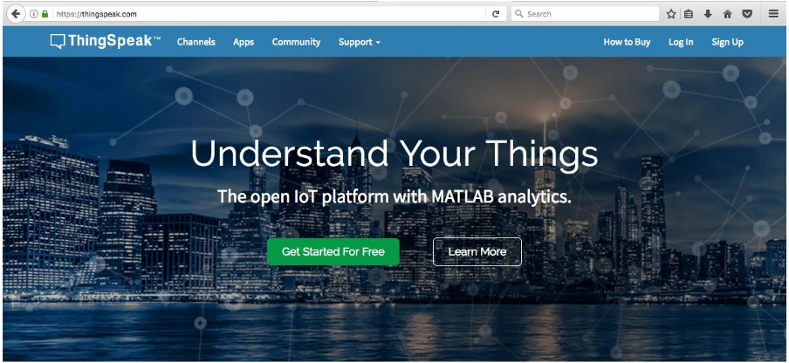
Open your web browser.
Go to https://www.thingspeak.com.
Your browser should display the page shown here:
Tektork Private Limited, Coimbatore

Slide 18
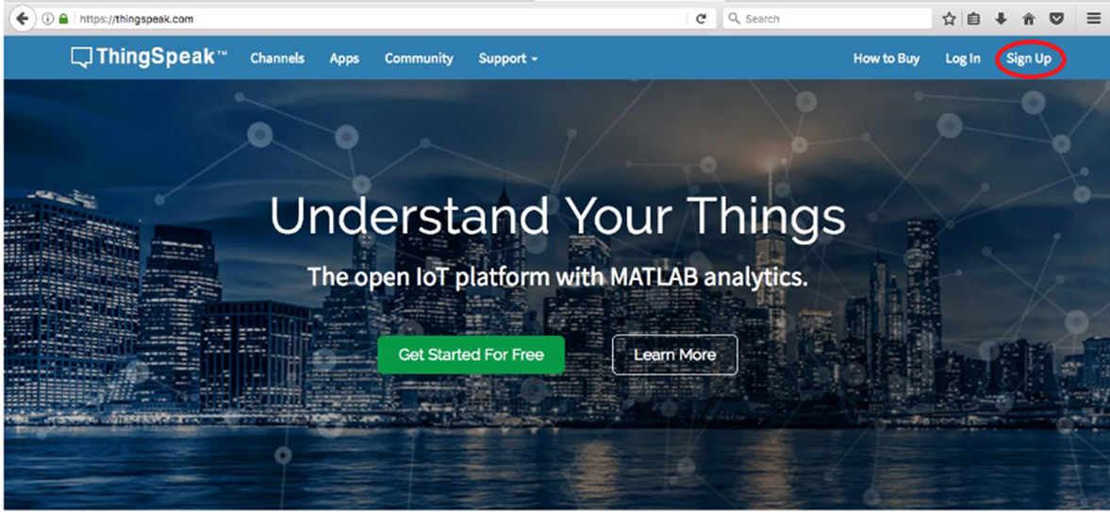
Click the Sign Up button located in the upper-right corner of the page.
Tektork Private Limited, Coimbatore

Slide 19
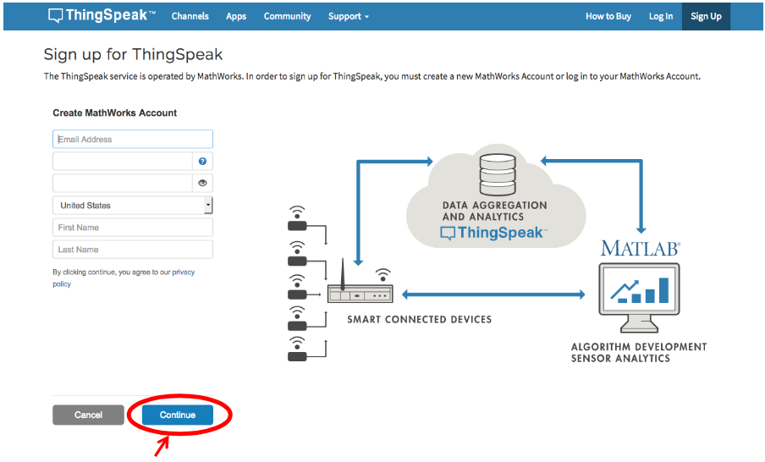
Fill in the required fields: email address, username, password, country, first name, and last name, then click the Continue button.
Tektork Private Limited, Coimbatore

Slide 20
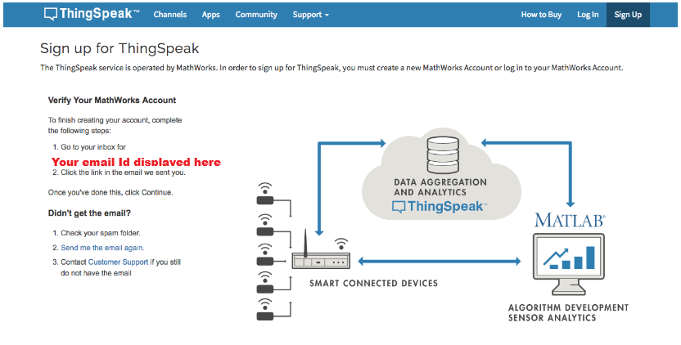
After clicking the Continue button, your screen will look like this.
Tektork Private Limited, Coimbatore

Slide 21
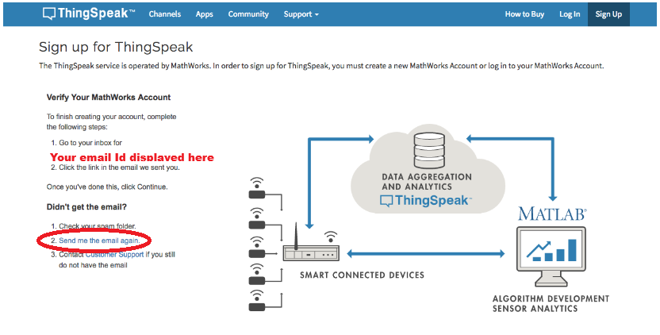
Open a new tab and check your email inbox for a message from "service" with the subject "Verify email address." Open this email and proceed to Next Step
*If the email is not in your inbox, check your spam folder. If it’s not there, choose the “Send me the email again” option in the window with ThingSpeak (see image below).
Tektork Private Limited, Coimbatore

Slide 22
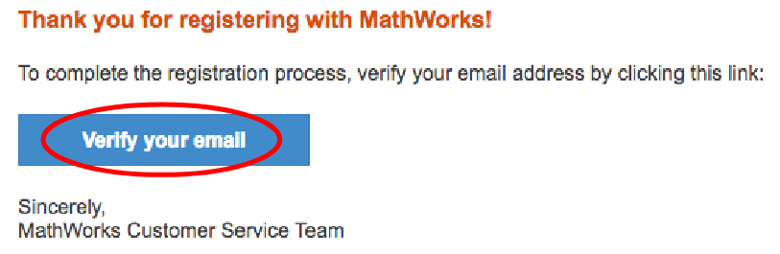
The message should look like the one shown below. Click “Verify Your Email.”
Tektork Private Limited, Coimbatore

Slide 23
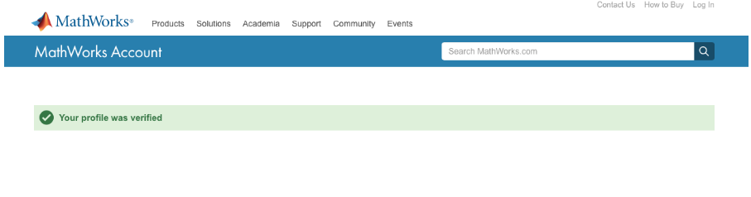
A confirmation page will appear. Notice that it opens a new tab for MathWorks Inc., the parent company of ThingSpeak.
Tektork Private Limited, Coimbatore

Slide 24

Go back to www.thingspeak.com and click Log In.
Tektork Private Limited, Coimbatore

Slide 25
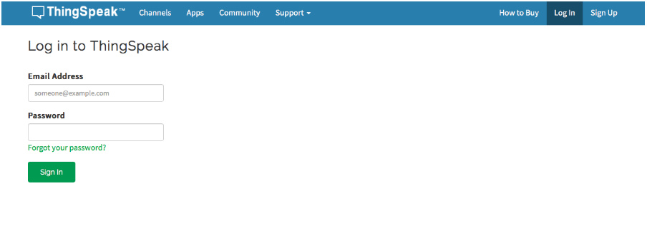
Enter your email address and password, then click “Sign In.”
Tektork Private Limited, Coimbatore

Slide 26
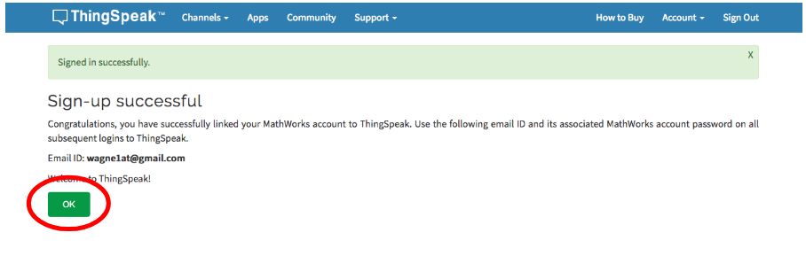
A confirmation page will appear. Click OK to proceed.
Tektork Private Limited, Coimbatore

Slide 27
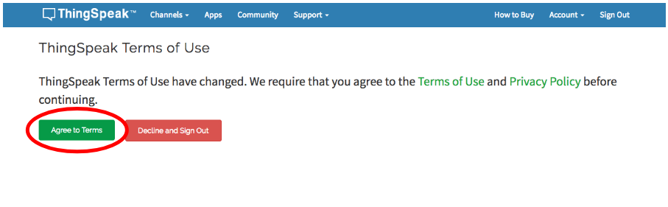
Read and agree to the Terms of Use.
Tektork Private Limited, Coimbatore

Slide 28
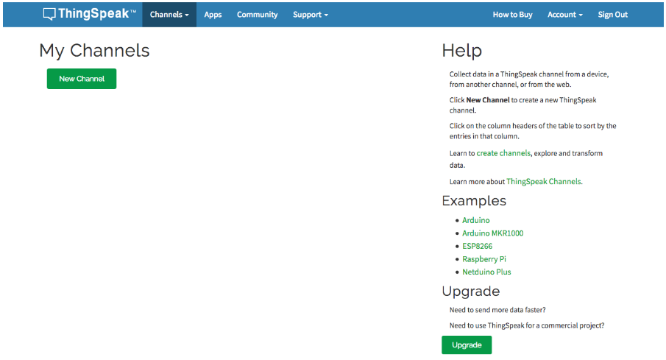
Congratulations! If your screen looks like the one below, you have successfully registered for ThingSpeak.
Tektork Private Limited, Coimbatore

Slide 29
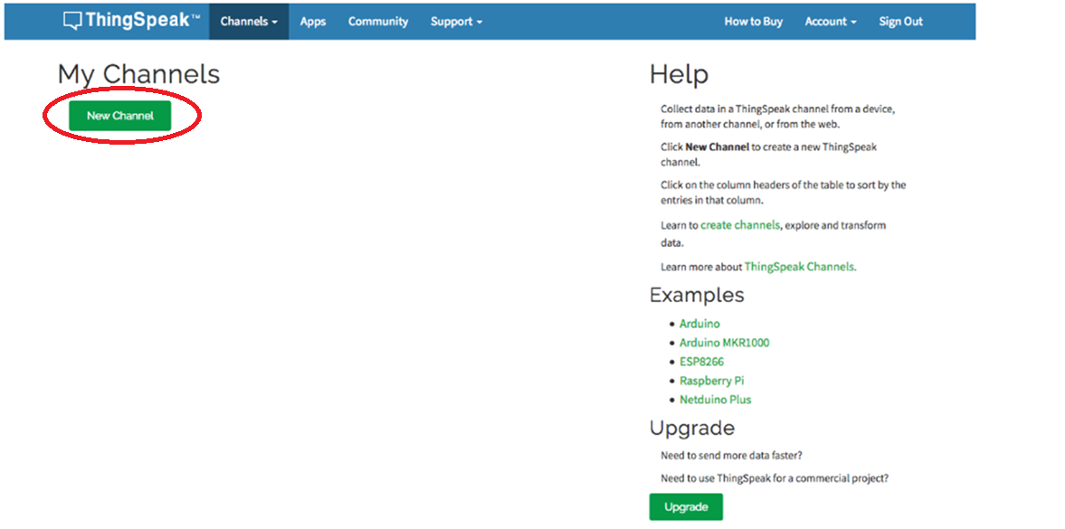
Click New Channel
Tektork Private Limited, Coimbatore

Slide 30
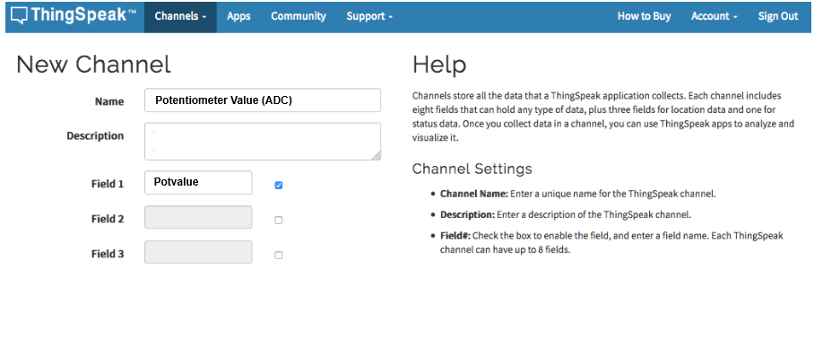
Create a single channel to collect the raw values from the potentiometer.
Tektork Private Limited, Coimbatore

Slide 31
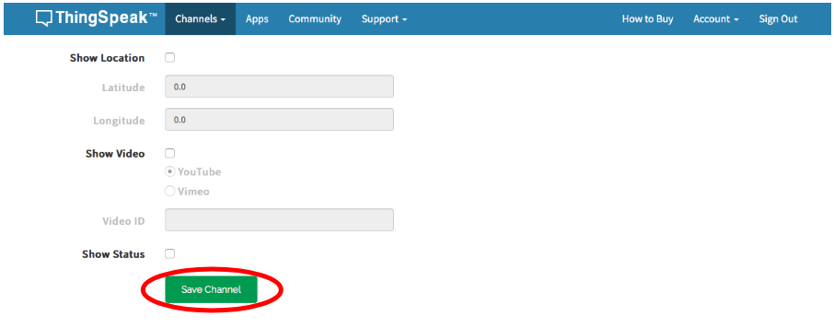
Scroll to the bottom and click “Save Channel.”
Tektork Private Limited, Coimbatore

Slide 32
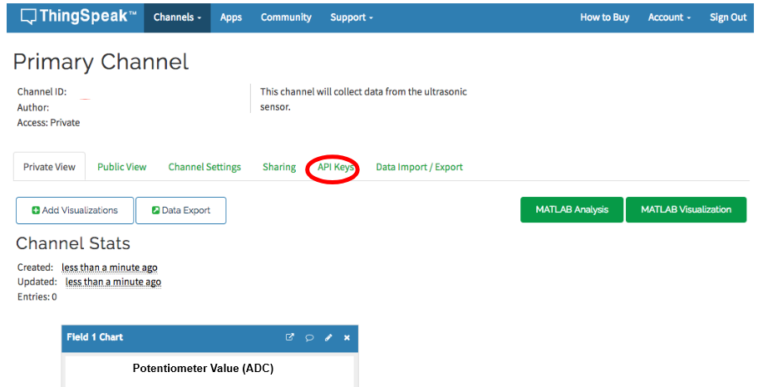
The screen should appear as shown below. Then, click the “API Keys” button.
Tektork Private Limited, Coimbatore

Slide 33
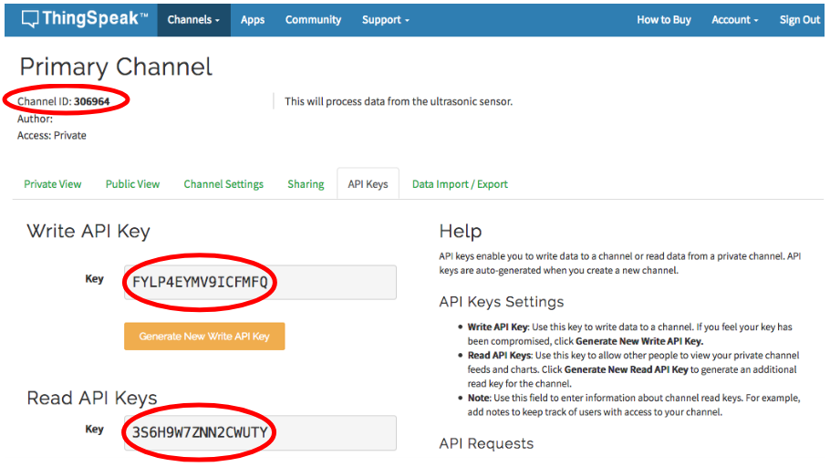
This is where the API Keys and the Channel ID for this channel are located. We will need all three of these for our code: the Channel ID, the Write API Key, and the Read API Key.
Tektork Private Limited, Coimbatore

Slide 34
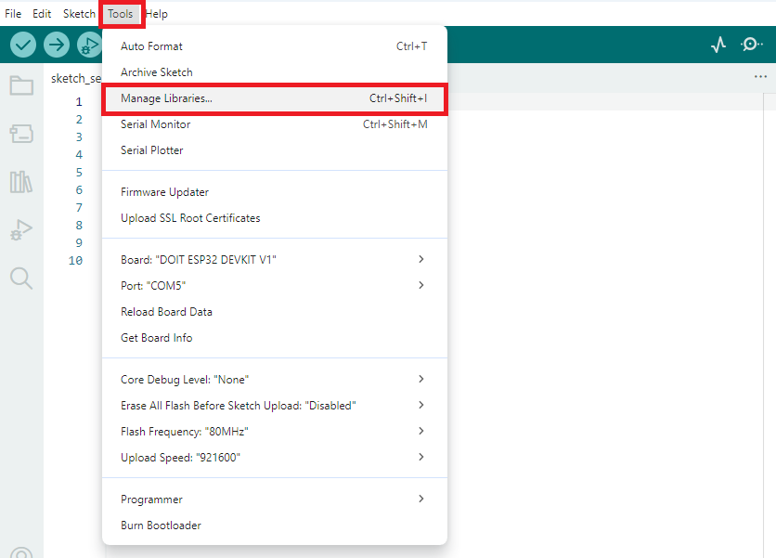
ThingSpeak - Library installation
In the Arduino IDE, go to the Tools menu, then select Manage Libraries... to open the Library Manager.
Tektork Private Limited, Coimbatore

Slide 35
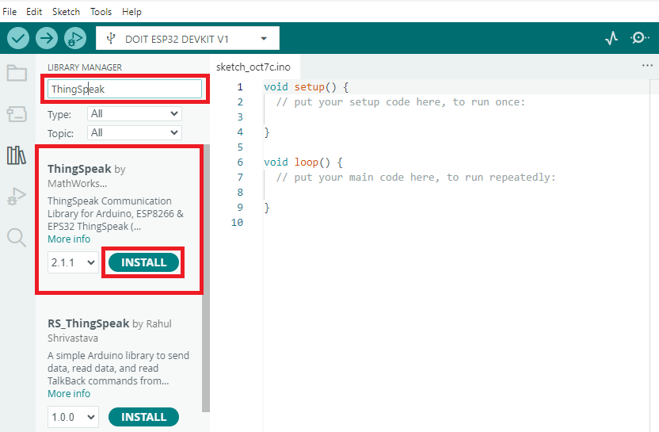
In the Library Manager search box, type ThingSpeak, then select the ThingSpeak library and click Install.
Tektork Private Limited, Coimbatore

Slide 36
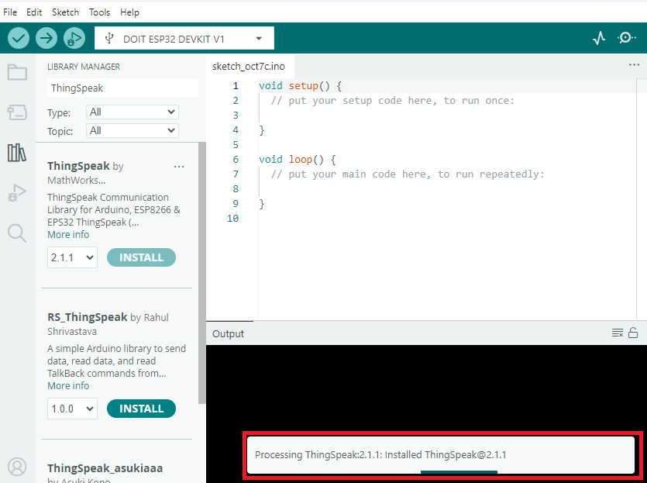
The installation of the ThingSpeak library is in progress. Wait until the installation is complete. Once it finishes, you can include the library in your Arduino sketch to send sensor data to the ThingSpeak cloud.
Tektork Private Limited, Coimbatore

Slide 37
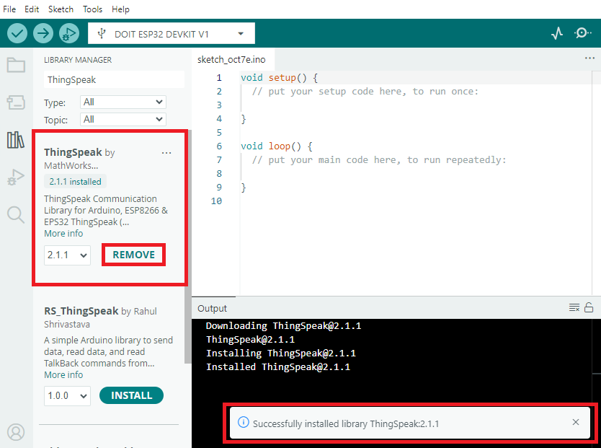
After the installation is complete, the Install button will change to Remove, and the output window will display the installation details.
Tektork Private Limited, Coimbatore

Slide 38
ThingSpeak - Potentiometer Code Code
#include <WiFi.h> // Include Wi-Fi library for ESP32
#include <ThingSpeak.h> // Include ThingSpeak library for IoT data communication
// Wi-Fi credentials - replace with your network's SSID and password
const char* ssid = “Your SSID";
const char* password = “Your Password";
WiFiClient client; // Create a Wi-Fi client object for network communication
// ThingSpeak channel configuration
unsigned long myChannelNumber = Your Channel Number; // Your ThingSpeak Channel ID (replace this)
const char* myWriteAPIKey = “Your Write API Key"; // Your ThingSpeak Write API Key (replace this)
// Potentiometer connection pin on ESP32
const int potPin = 36; // GPIO 3 analog input connected to potentiometer output
// Variables for timing data uploads to ThingSpeak
unsigned long lastTime = 0; // Stores the timestamp of the last upload
unsigned long timerDelay = 20000;// Delay between uploads (20 seconds, free ThingSpeak limit)
Tektork Private Limited, Coimbatore

Slide 39
void setup()
{
Serial.begin(115200); // Start serial communication at 115200 baud for debugging
// Connect to Wi-Fi as station mode
WiFi.mode(WIFI_STA);
WiFi.begin(ssid, password);
Serial.print("Connecting to WiFi ..");
// Wait in a loop until connection is established
while (WiFi.status() != WL_CONNECTED) {
Serial.print('.'); // Print dots as connection attempts
delay(1000); // Wait 1 second before retrying
}
// Connection successful - print confirmation and network details
Serial.println("\n Connected successfully!");
Serial.print(" SSID: ");
Serial.println(WiFi.SSID()); // Print connected Wi-Fi SSID
Serial.print(" IP Address: ");
Serial.println(WiFi.localIP()); // Print assigned ESP32 IP address
ThingSpeak.begin(client); // Initialize ThingSpeak using the Wi-Fi client
}
Tektork Private Limited, Coimbatore

Slide 40
void loop() {
// Execute this block only after timerDelay time has elapsed
if ((millis() - lastTime) > timerDelay) {
// Check if Wi-Fi is still connected
if (WiFi.status() != WL_CONNECTED) {
Serial.print("Attempting to reconnect to WiFi");
WiFi.begin(ssid, password);
// Reconnect until successful
while (WiFi.status() != WL_CONNECTED) {
Serial.print('.');
delay(5000);
}
Serial.println("\nReconnected.");
// Print Wi-Fi connection details after reconnecting
Serial.print(" SSID: ");
Serial.println(WiFi.SSID());
Serial.print(" IP Address: ");
Serial.println(WiFi.localIP());
}
Tektork Private Limited, Coimbatore

Slide 41
// Read analog potentiometer value (range from 0 to 4095)
int potValue = analogRead(potPin);
Serial.println("Potentiometer Value: " + String(potValue)); // Print value to serial monitor
// Write potentiometer value to ThingSpeak channel Field 1
int x = ThingSpeak.writeField(myChannelNumber, 1, potValue, myWriteAPIKey);
// Check response of ThingSpeak update attempt
if (x == 200) {
Serial.println("Channel update successful."); // Success message
} else {
Serial.println("Problem updating channel. HTTP error code " + String(x)); // Error message
}
lastTime = millis(); // Update last upload time to current time
}
}
Tektork Private Limited, Coimbatore

Slide 42
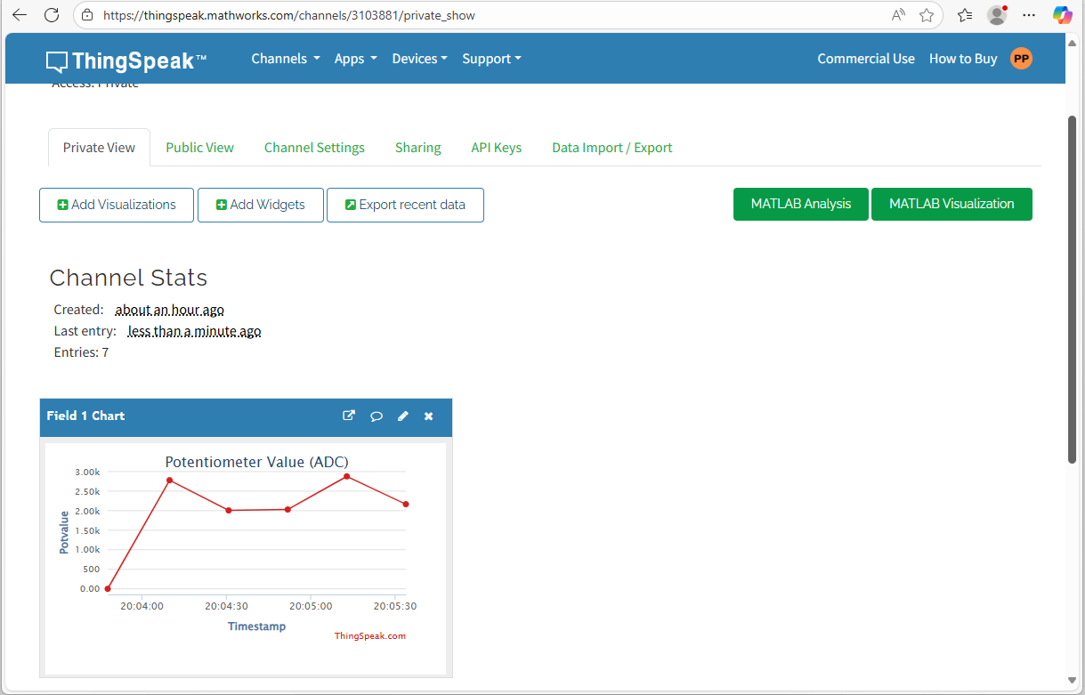
Output
Tektork Private Limited, Coimbatore

Slide 43
Thank You
Tektork Private Limited, Coimbatore

